Slide 1

Lariat 2019 Revenue Increase
Strategies and Projections
Notes:
Hello, today we are going to review the opportunities Lariat has available for increasing its profitability for the 2019 fiscal year*
*This projection was performed with incomplete data sets and should not be assumed to be completely accurate. However, it may be used as a guide to show opportunities for growth and improvements, and as the framework for a more detailed and in-depth analysis with the addition of the required data.

Slide 2
Topics For Review
Reduction of Locations
Modifying Product Mix
Inventory Increase
Rate Increases
Notes:
The strategies to be covered today are;
Elimination of those locations where revenue falls below threshold, and the reallocation of inventory to more profitable locations.
Adjustment of inventory by selling vehicles earning below threshold, and a re-allocation of funds towards higher ROI assets.
We will also look at the projected investment for 2019.
Lastly, we will look at the projected rate increases for the 2019 fiscal year.

Slide 3
Reduction of Locations and Further Market Analysis
Closure of locations producing $49.5k or less per year
Total revenue for 2018 is $ 1,242,750
Underperformer Revenue $ 516,769
Reallocation of inventory to higher producing markets
Increasing revenue by $ 17,225 per location
Notes:
We have identified 11 locations where revenue is commonly under fifty thousand dollars per year.
By focusing on eliminating locations, and reallocation to more profitable markets, we can reduce overhead and operating expenses.

Slide 4
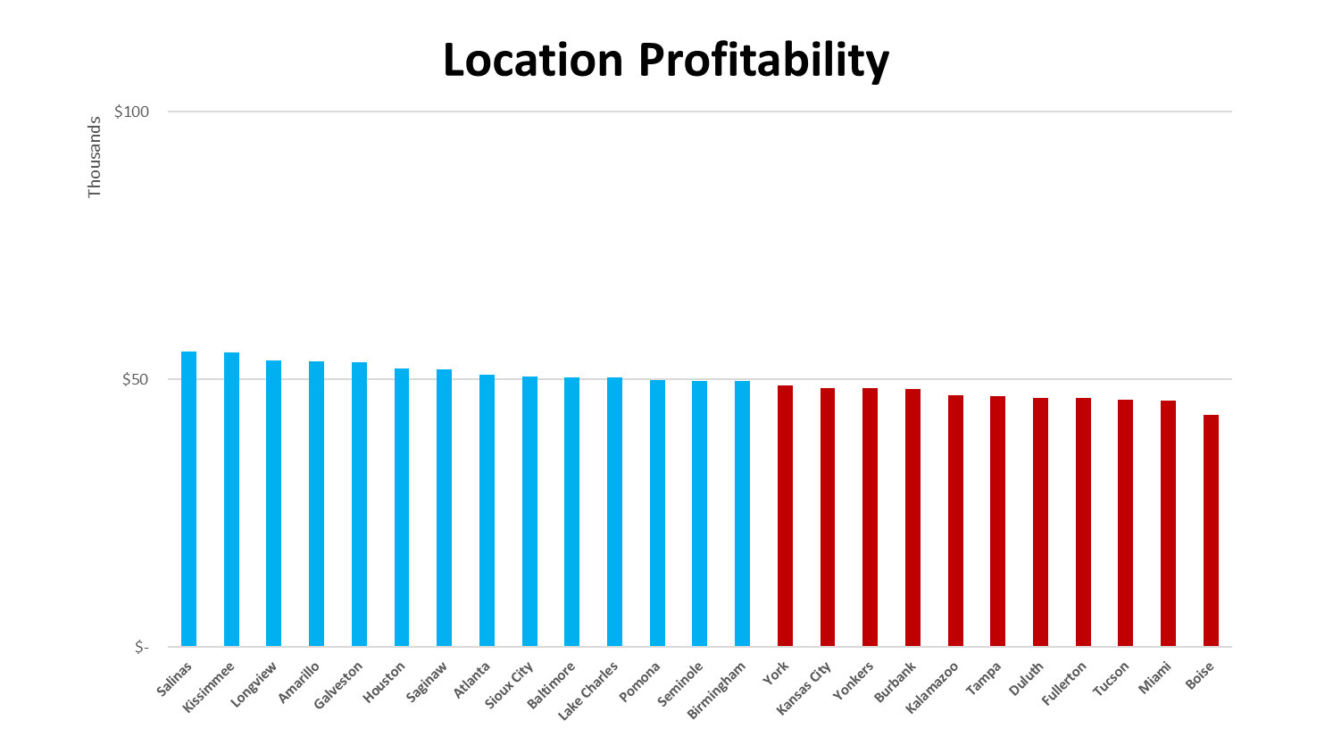
Identification of Underperforming Locations
Performing
Locations
Underperforming
Locations
Notes:
Looking at all locations, we can see 26 percent are bringing in less than 49.5 thousand in gross revenue per year.
The elimination of these underperformers and the re-allocation of inventory throughout the remaining thirty locations, while not increasing overall profits, would increase per location revenue.
While not reflected in this projection, the reduction of operating and other overhead costs, would also reflect positively in the reduction of expenditures for 2019, increasing overall profitability.

Slide 5
2019 Reallocation Breakdown
Revenue Increase per Locations for 2019
Locations 2018 | Underproducing Locations 2018 | Top Revenue Cities 2018 | Revenue all Cities 2018 | Revenue all Underperforming Cities 2018 | Funds reallocated per location 2019 | Per Location Revenue Before Reallocation 2018 | Per Location Revenue After Reallocation 2019
41 | 11 | 30 | $ 1,242,750 | $ 516,769 | $ 17,226 | $ 30,310 | $ 41,425
Notes:
Here we can see the results of the re-allocation, as presented in the above table.
The remaining 30 locations could expect a projected increase of over 17K in revenue per location, bringing average revenues to over 41k.

Slide 6
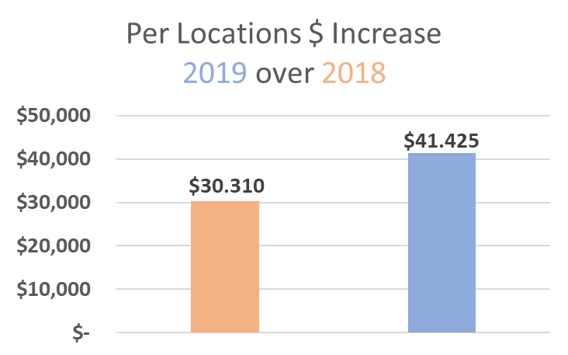
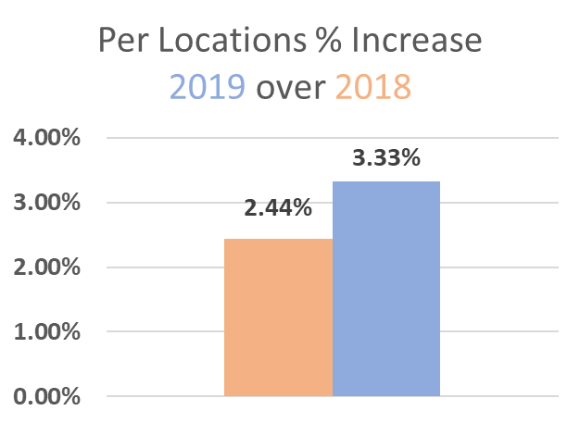
2018 – 2019 Comparison
Notes:
Here we can see the projection of the re-allocation, as presented in the above table, broken down into a year over year comparison.
This shows the projected revenue amounts per location by both dollar amount and percentage growth expected.

Slide 7
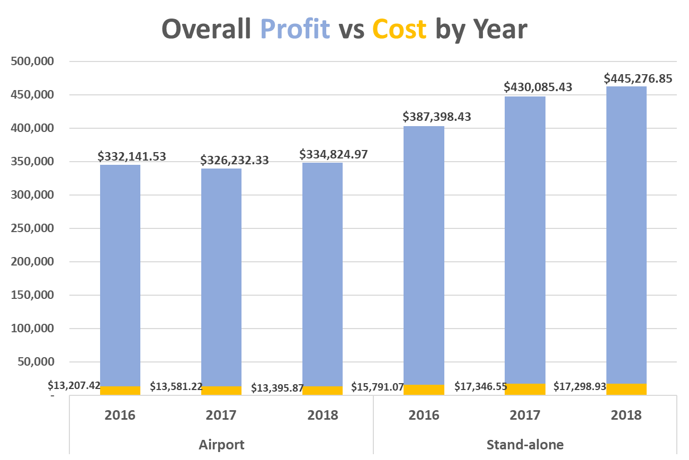
Location ROI
Notes:
Here we see profit over cost split out into both venue and model year revenue.
While operational costs are higher in the stand-alone locations, the profits earned outweigh the additional incurred costs.
Also, the stand-alone venues show a markedly larger volume over the airport locations they also show a greater tendency for the newer model years to dominate the revenue stream.
This data provided the foundation on which to forecast inventory purchasing for the 2019 fiscal year…

Slide 8
Evaluation of Inventory Mix for ROI
Divestment of inventory with low ROI
Identify assets with higher ROI
Modify inventory assortment to higher ROI investments
Notes:
These three steps have been identified for adjusting to higher ROI assets.
Analysis has already been done to identify assets for divestment and investment is available for further review.
We will also determine what the year over year increase in fees should be and provide projections on target revenues.

Slide 9
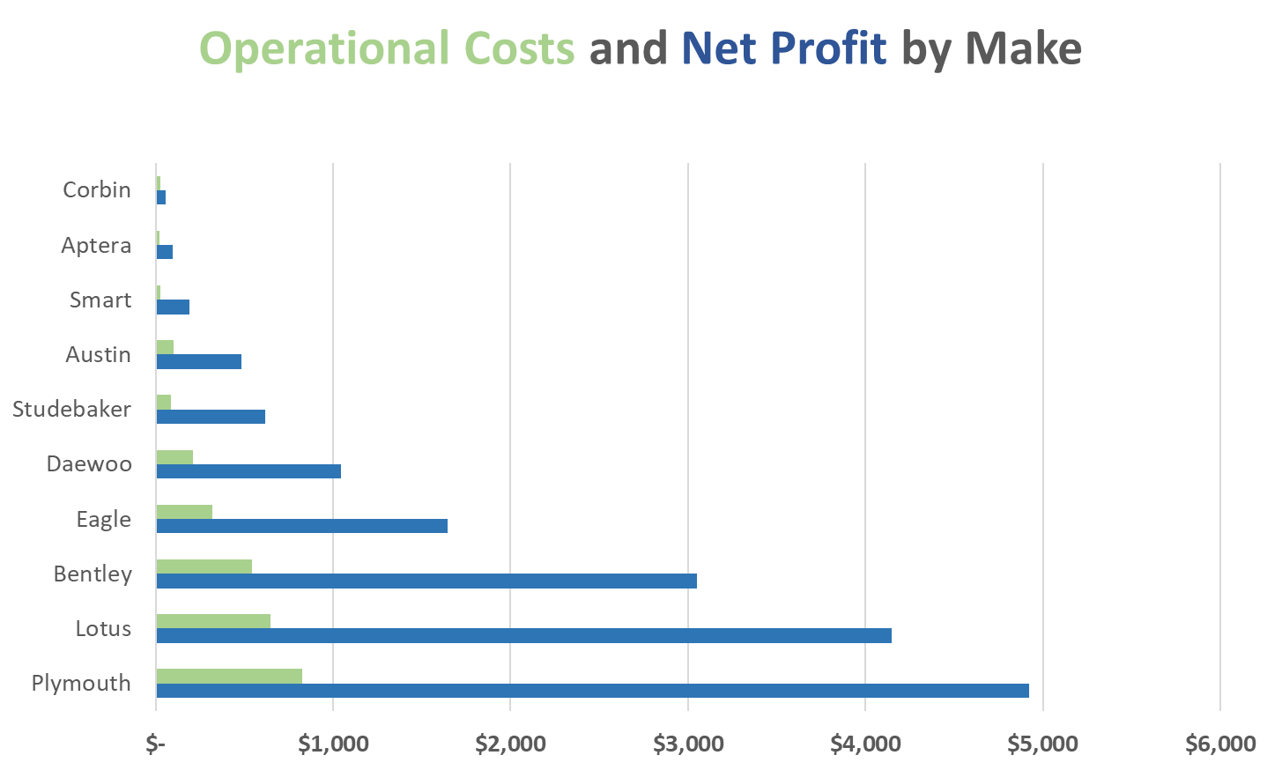
Inventory ROI
Notes:
This data shows the seven brands which produce revenue of less than twenty-five hundred dollars per year.
By eliminating these vehicles and reinvesting those sales proceeds into higher ROI assets, an increase in overall profits can be expected.

Slide 10
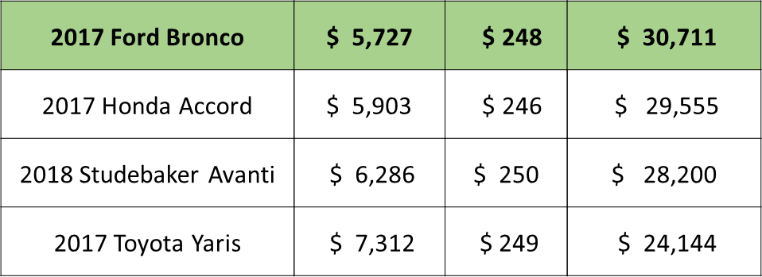
Reinvestment Decision Analysis
Top four vehicles identified
Cost of Vehicle
Daily
Rate
Projected
Net
Year, Make, Model
Total reinvestment amount $101,385
Notes:
The top four vehicles identified for inventory increases are as shown, with the 2017 Ford Bronco being the top pick for affordability and ROI.*
*Incomplete data available, projections estimated by averaging of data available.

Slide 11
2019 Inventory and Rate Projections
MODEL YEAR | PROFIT PER YEAR | NUMBER OF VEHICLES PER MODEL YEAR | REVENUE PER VEHICLE MODEL YEAR | INCREASE PER MODEL YEAR | YEAR OVER YEAR CHANGE | YEAR OVER YEAR VARIANCE | 2019 RENTAL RATE
2016 | $ 719,540 | 1284 | $ 560
2017 | $ 756,318 | 1360 | $ 556 | -4 | 5%
2018 | $ 780,102 | 1355 | $ 576 | 20 | 3% | 4%
2019 | $ 845,836 | 1411 | $ 600 | 56 | 8% | 6% | $ 24
$ 65,735
Notes:
Projections show, based on year over year, the number of 2019 vehicles necessary to maintain growth as indicated with the previous model year increases.
With an addition of 1411 new vehicles, rental rates should increase by $24 dollars. Bringing revenue per vehicle to $600 and profit up to $845,836 dollars.
This works out to a projection of to $65,735 dollars increase in profit.

Slide 12
Summary of Revenue Projections
Re-allocation proposal
$ 516,780
Inventory adjustments
$ 65,735
Rate adjustments
$ 96,446
Combination of the two proposals
$ 678,958
Projection of profits with implementation of all options $ 1,921,708
A projected increase of 55%
Notes:
By implementing all the proposals, there is a projected increase of over half a million dollars.
With a projected percentage of increase of revenue over 50%

Slide 13
In Review
Closure and reallocation to more cost-effective markets
Realignment of inventory for ROI leverage
Increase of assets to account for projected growth
Increase to daily rates
Notes:
In order to achieve a 55% increase in overall profitability, the company should consider implementing the following recommendations: closure of underperforming locations, reallocation of inventory, increasing inventory with higher return on investment (ROI) assets, and raising rental rates. By incorporating these strategies, the company will be able to reduce costs, enhance revenue per location, and improve overall profitability.

